Slide 1

SIDDAGANGA INSTITUTE OF TECHNOLOGY
TUMAKURU-572103
(An Autonomous Institute affiliated to VTU)
PERSONALIZED GUI
DEPARTMENT OF INFORMATION SCIENCE AND ENGINEERING
Project Members:
Pallavi Pratik :1SI14IS028
Pawan Kumar Ganjhu :1SI14IS029
Shubham Mishra :1SI14IS046
Guided by:
Mrs. Jagadamba. G.
Assistant Professor
Dept. of ISE

Slide 2
PROBLEM STATEMENT
Organized Home Browser
Personalized add-on application for user.
User friendly.
Giving organized browsing experience.

Slide 3



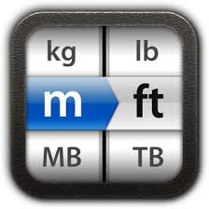
INTRODUCTION*progress
WORK DONE
ALARM CLOCK
CLIPBOARD
WORK TO BE DONE
CALCULATOR
UNIT CONVERTOR

Slide 4
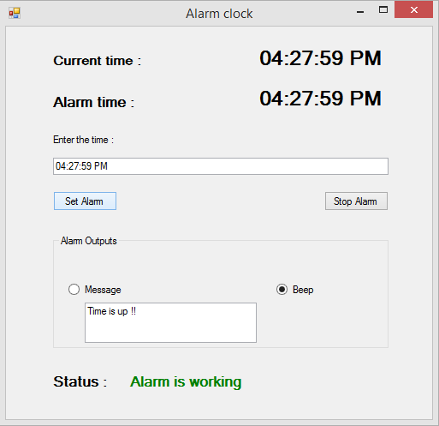
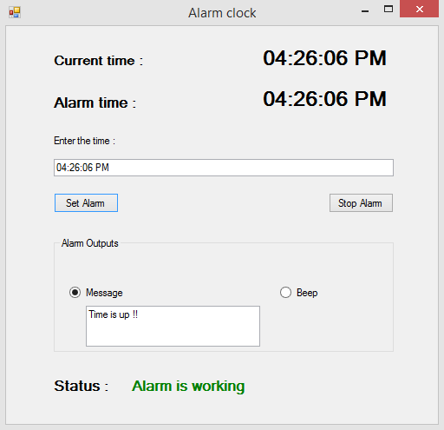
A screenshot of the application

Slide 5
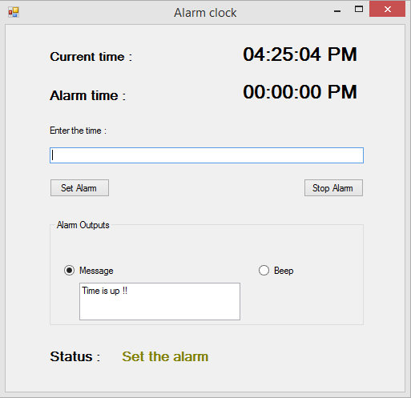
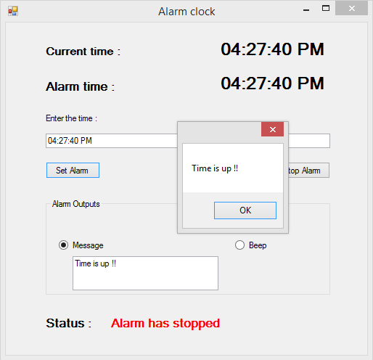

Slide 6
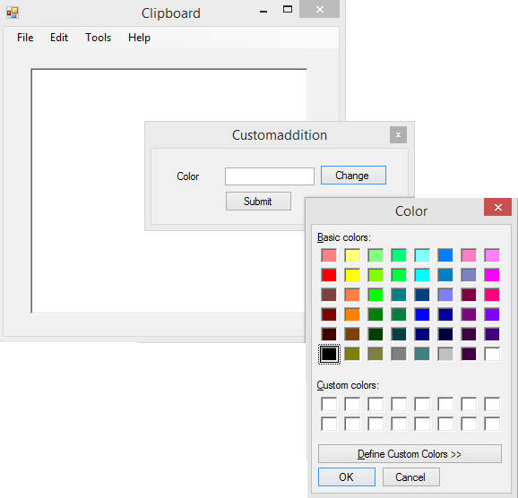
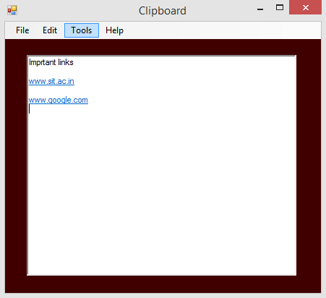

Slide 7

EXPECTED VIEW OF HOMEPAGE
Alarm clock
Calcula tor
Clipboard
Convertor
https://www.youtube.com/results?search_query=qt+tutorial
5:00 pm
Alarm clock
Clipboard
+ | -
* | /
= | %
ans:
kg
$
m
ft
Convertor
Calculator

Slide 8
APPLICATION
It is a personalized application.
It is an add-on application.
It minimizes the watchdog timer.
Helps in proper time scheduling.
Allows multiple links to be saved together in clipboard.
Calculated result can be saved.
Unit convertor has many physical units to be converted.
It has social benefit as well.

Slide 9
CONCLUSION
Time saver.
User-friendly utility.
Easy to perform unit conversions.
Makes basic calculations handy.
Jot down important points and link from web.

Slide 10
SUGGESTIONS…

